Slide 1

MSc Information Systems Development and Security at AUEB
Subject: Cybersecurity
Professor: Dr. Gritzalis
Students: Athanasiou Lydia
Drougka Sofia

Slide 2
OWASP Top Ten Changes Between 2010 and 2013
OWASP maintains the Top 10 list and has done so since 2003. Every 2-3 years the list is updated in accordance with advancements and changes in the AppSec market.
OWASP TOP 10-2010 (Previous)
A1 – Injection
A3 - Broken Authentication and Session Management
A2 - Cross Site Scripting (XSS)
A4 - Insecure Direct Object References
A6 - Security Misconfiguration
A7 - Insecure Cryptographic Storage – merged with A9
A8 - Failure to Restrict URL Access – Broadened into
A5 - Cross Site Request Forgery (CSRF)
<buried in A6: Security Misconfiguration>
A10 - Unvalidated Redirects and Forwards
A9 - Insufficient Transport Layer Protection
OWASP TOP 10 – 2013 (New)
A1 – Injection
A2 - Broken Authentication and Session Management
A3 - Cross Site Scripting (XSS)
A4 - Insecure Direct Object References
A5 – Security Misconfiguration
A6 – Sensitive Data Exposure
A7 – Missing Function Level Access Control
A8 – Cross Site Request Forgery (CSRF)
A9 – Using Known Vulnerable Components
A10 – Unvalidated Redirects and Forwards
Merged with 2010-A7 into new 2013-A6

Slide 3
OWASP Top Ten Changes Between 2013 and 2017
OWASP TOP 10 - 2013
A1 – Injection
A2 – Broken Authentication and Session Management
A3 – Cross-Site Scripting (XSS)
A4 – Insecure Direct Object References [Merged + A7]
A5 – Security Misconfiguration
A6 – Sensitive Data Exposure
A7 – Missing Function Level Access Control [Merged +A4]
A8 – Cross-Site Request Forgery (CSRF)
A9 – Using Components with Known Vulnerabilities
A10 – Unvalidated Redirects and Forwards
OWASP TOP 10 - 2017
A1:2017 – Injection
A2:2017 – Broken Authentication
A3:2017 – Sensitive Data Exposure
A4:2017 – XML External Entities (XXE)
A5:2017 – Broken Access Control
A6:2017 – Security Misconfiguration
A7:2017 – Cross-Site Scripting (XSS)
A8:2017 – Insecure Deserialization [New, Community]
A9:2017 – Using Components with Known Vulnerabilities
A10:2017 – Insufficient Logging and Monitoring [New, Community]
New
Merged
New, Community
New, Community

Slide 4
OWASP Top Ten Changes Between 2017 and 2021
2017
A01:2017 - Injection
A02:2017 - Broken Authentication
A03:2017 - Sensitive Data Exposure
A04:2017 – XML External Entities (XXE)
A05:2017 - Broken Access Control
A06:2017 - Security Misconfiguration
A07:2017 - Cross-Site Scripting (XSS)
A08:2017 - Insecure Deserialization
A09:2017 - Using Components with Known Vulnerabilities
A10:2017 - Insufficient Logging & Monitoring
2021
A01:2021 - Broken Access Control
A02:2021 - Cryptographic Failures
A03:2021 - Injection
A04:2021 – Insecure Design
A05:2021 - Security Misconfiguration
A06:2021 – Vulnerable and Outdated Components
A07:2021 – Identification and Authentication Failures
A08:2021 – Software and Data Integrity Failures
A09:2021 – Security Logging and Monitoring Failures
A10:2021 – Server-Side Request Forgery (SSRF)
Merged
New
Merged
New
New

Slide 5
A1:2021 – Broken Access Control ←A5:2017- Broken Access Control
Moves up from the fifth position to the category with the most serious web application security risk; the contributed data indicates that on average, 3.81% of applications tested had one or more Common Weakness Enumerations (CWEs) with more than 318k occurrences of CWEs in this risk category. The 34 CWEs mapped to Broken Access Control had more occurrences in applications than any other category.
Another two risks from the 2013 version were merged in the 2017 OWASP Top 10: Insecure direct object references and missing function level access control were merged into broken access control.
Access control enforces policy such that users cannot act outside of their intended permissions. Failures typically lead to unauthorized information disclosure, modification, or destruction of all data or performing a business function outside the user’s limits
Prevention:
Use penetration testing in order to detect unintended access-controls
Deny by default
Log access control failures
Alert admins when appropriate (e.g., repeated failures)
Model access controls should enforce record ownership rather than accepting that the user can create, read, update, or delete any record
Implement access control mechanisms once and re-use them throughout the application, including minimizing Cross-Origin Resource Sharing (CORS) usage.

Slide 6

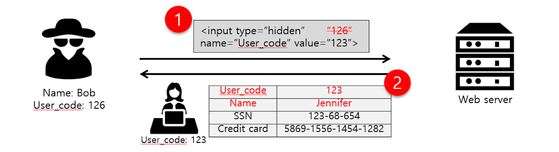
A1:2021 – Broken Access Control ←A5:2017- Broken Access Control
Example:
The application uses unverified data in a SQL call that is accessing account information:
An attacker simply modifies the browser's 'acct' parameter to send whatever account number they want. If not correctly verified, the attacker can access any user's account.
pstmt.setString(1, request.getParameter("acct"));
ResultSet results = pstmt.executeQuery( );
https://example.com/app/accountInfo?acct=notmyacct
Bug Bounty for Beginners (part 2) broken access control | by Sayin0 | Medium

Slide 7
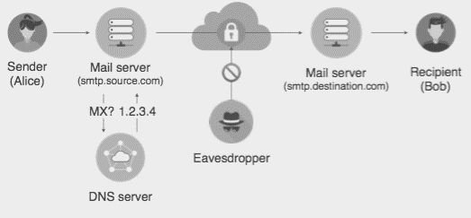
A2:2021 –Cryptographic Failures ← Sensitive Data Exposure
The renewed name focuses on failures related to cryptography as it has been implicitly before.
Sensitive data exposure is when important stored or transmitted data (such as social security numbers) is compromised.
Example: Financial institutions that fail to adequately protect their sensitive data can be easy targets for credit card fraud and identity theft.
Some sensitive data that requires protection is: Credentials, Credit card numbers, Social Security Numbers, Medical information, Personally identifiable information (PII) etc
Responsible sensitive data collection and handling have become more noticeable especially with the General Data Protection Regulation (GDPR). This is a new data privacy law that came into effect May 2018. It mandates how companies collect, modify, process, store, and delete personal data.
Types of attack: SQL Injection, Phishing Attack, Man in the middle attack
Detection: Data leak detection using scanning tools
Prevention:
Enforce Strict Data Encryption
Have a well-defined password policy
Give access to data if required
Encrypt backups as well
Cryptographic Failures in Practice | by Frank Wang | MIT Security Seminar | Medium

Slide 8
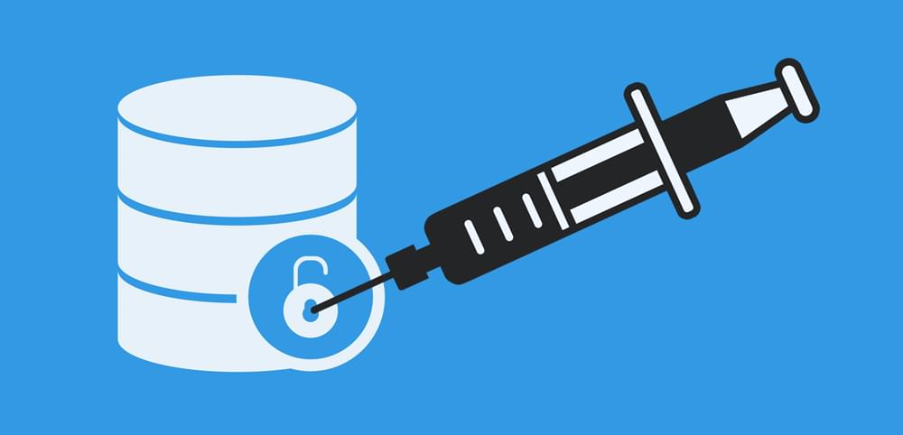
A3:2021 – Injection ← A1:2017-Injection & A7:2017-CSS
Injection ½:
It slides down to the third position and Cross-site Scripting is now part of this category in this edition.
Injection occurs when malicious data is sent by an attacker into a web application. The attacker’s intent is to make the application do something it was not designed to do.
SQL injection is one of the most common injection flaws found in applications (33.3%) and it can be caused by use of untrusted data by an application when constructing a vulnerable SQL call.
Most common example is the SQL query consuming untrusted data:
This query can be exploited by calling up the web page executing it with the following URL: http://example.com/app/accountView?id=’ or ‘1’=’1 causing the return of all the rows stored on the database table.
The SQL injection cause a leak of sensitive data and compromise an entire WordPress installation.
Anything that accepts parameters as input can potentially be vulnerable to a code injection attack.
String query = “SELECT * FROM accounts WHERE custID = ‘” + request.getParameter(“id”) + “‘”;

Slide 9
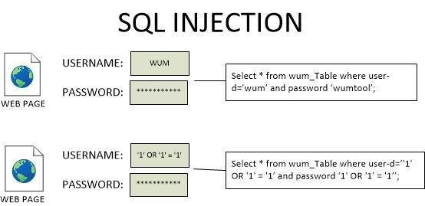
A3:2021 – Injection ← A1:2017-Injection & A7:2017-XSS
Injection 2/2:
Detection: Database firewall, Injection Detection System, Vulnerabilities scanning tools (w3af, Burp, sqlmap etc)
Prevention:
Strong validation and sanitization of the data used by the web application, using encryption.
Use a safe API, which avoids using the interpreter entirely, provides a parameterized interface, or migrates to Object Relational Mapping Tools (ORMs).
A SQL injection attack. | Download Scientific Diagram (researchgate.net)

Slide 10

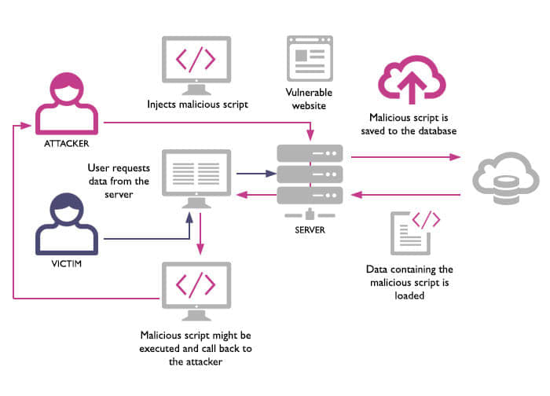
A3:2021 – Injection ← A1:2017-Injection & A7:2017-XSS
Cross-Site Scripting (XSS):
Cross-Site Scripting (XSS) is a type of injection where malicious scripts are injected in trusted websites. Usually, XSS attacks have the form of a browser side script. They occur anywhere a web application uses input from a user without including any validation or encoding.
Types of Attack
Stored XSS Attacks
Blind Cross-site Scripting
Reflected XSS Attacks
Detection
Code Review
Use special purpose detection software such as XSS Scanners
Prevention
Apply encoders to sanitize untrusted data.
Never Insert Untrusted Data Except in Allowed Locations
JavaScript Encode Before Inserting Untrusted Data into JavaScript Data Values
URL Encode Before Inserting Untrusted Data into HTML URL Parameter Values
Avoid JavaScript URLs

Slide 11

A04:2021 – Insecure Design
Is a new category for 2021, with a focus on risks related to design flaws. It calls for more use of threat modeling, secure design patterns and principles, and reference architectures.
Insecure design is a broad category representing different weaknesses, expressed as “missing or ineffective control design.” It cannot be fixed by a perfect implementation as by definition, needed security controls were never created to defend against specific attacks.
One of the factors that contribute to insecure design is the lack of business risk profiling inherent in the software or system being developed, and thus the failure to determine what level of security design is required.
Prevention
Establish and use a secure development lifecycle with AppSec professionals to help evaluate and design security and privacy-related controls
Establish and use a library of secure design patterns or paved road ready to use components
Use threat modeling for critical authentication, access control, business logic, and key flow
Write unit and integration tests to validate that all critical flows are resistant to the threat model.
Limit resource consumption by user or service

Slide 12
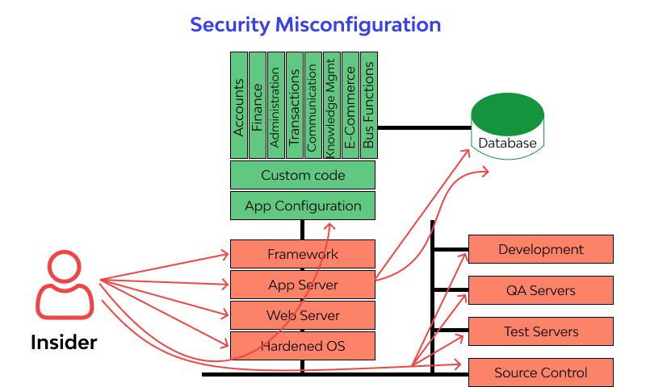
A5:2021 –Security Misconfiguration→A4:2017-XXE & A6:2017-Security Misconfiguration
Security Misconfiguration:
Security Misconfiguration is defined as failing to implement all the security controls for a server or web application, or implementing the security controls, but doing so with errors.
Types of Attack
Brute force/credential stuffing
Code & command injection
Buffer overflow
Forceful browsing
Detection
Continuous identification of application security posture with web security
firewall through automated security scans and manual Pen-Testing (SonarQube, AppTrana).
Prevention
Change credentials (usernames, passwords) for default accounts regularly
Upgrade or remove out-of-date software versions
Close all unnecessary services and ports
Use logs for system monitoring
https://www.wallarm.com/what/a6-security-misconfiguration-2017-owasp

Slide 13
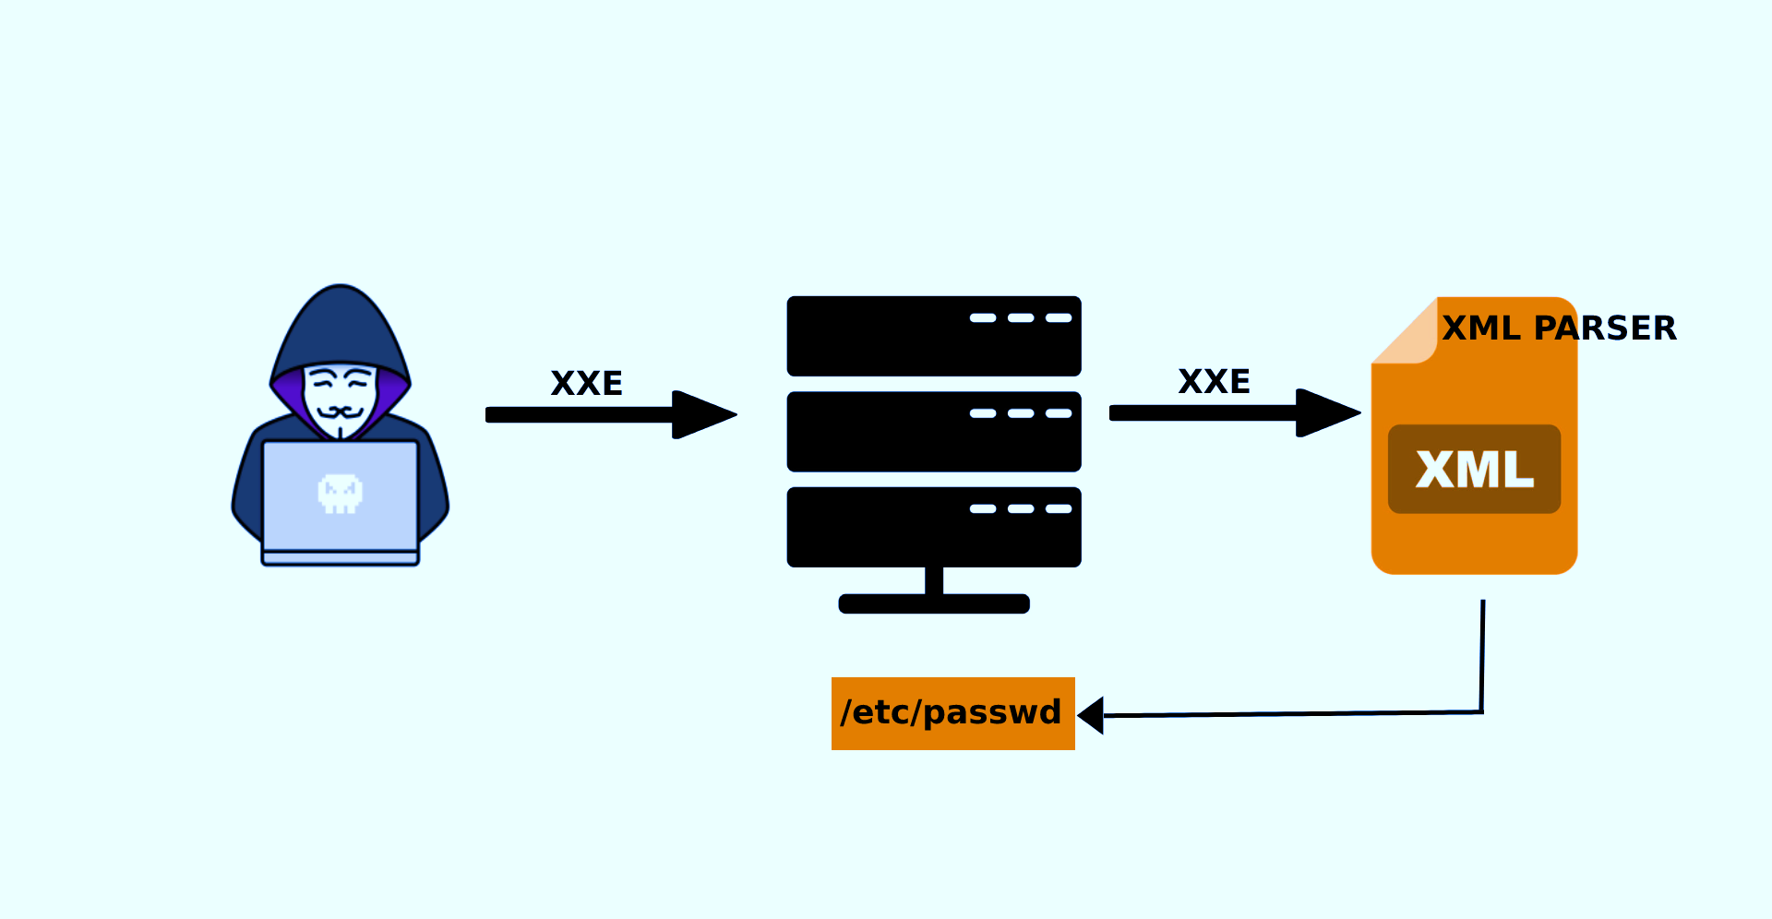
A5:2021 –Security Misconfiguration←A4:2017-XXE & A6:2017-Security Misconfiguration
XML External Entities (XXE):
It moves up from #6 in the previous edition. The former category for A4:2017-XML External Entities (XXE) is now part of this risk category
XML External Entities (XXE): Attackers can take advantage of web applications that use vulnerable component processing XML’s via uploading XML or by including hostile commands or content within an XML document.
Example: An attacker attempts a denial-of-service attack by including a potentially endless file
According to the OWASP Top 10, the XML external entities (XXE) main attack vectors include the exploitation of:
Vulnerable XML processors if malicious actors can upload XML or include hostile content in an XML document
Vulnerable code, dependencies or/and integrations.
Prevention:
Use less complex data formats ,such as JSON, and avoid serialization of sensitive data.
Patch or upgrade all XML processors and libraries in use by the application or on the underlying operating system.
Use dependency checkers (update SOAP to SOAP 1.2 or higher).
Disable XML external entity and DTD processing in all XML parsers in the application.
Verify that XML or XSL file upload functionality validates incoming XML using XSD validation or similar.
SAST tools can help detect XXE in source code – although manual code review is the best alternative in large, complex applications with many integrations.

Slide 14
A06:2021 – Vulnerable and Outdated Components ← A09:2017 - Using Components with Known Vulnerabilities
The process of using software components with known gaps in security which can be identified and exploited by hackers or intruders. Renamed Vulnerable and outdated components in OWASP 2021.
Almost all applications contain vulnerabilities, due to weaknesses of their components or dependency libraries. Most vulnerabilities are unintentional but some are deliberately left by developers.
Types of Attack
Code injection on web or database server
Cross site scripting
Detection
Use specialized vulnerability detection tools such as HDIV, Crashtest Security Suite.
Prevention
Identify all components, versions, dependencies and libraries used by the application.
Establish security policies and best practices for component use, including acceptable licenses.
Monitor known security vulnerabilities in databases, project newsletters, mailing lists etc.
Add security wrappers to components, including the disablement of unnecessary functionalities.

Slide 15


A7:2021 – Identification and Authentication Failures ← A2:2017- Broken Authentication
It was previously Broken Authentication and is sliding down from the second position.
Certain applications are often improperly implemented. Specifically, functions related to authentication and session management, when implemented incorrectly, allow attackers to compromise passwords, keywords, and sessions.
A broken authentication vulnerability can allow an attacker to use manual and/or automatic methods to try to gain control over any account they want in a system or to gain complete control over the system.
Types of Attack: Phishing attack, Brute force attack, Man in the middle attack
Detection: Black-list/White-list based tools
Example: A web application allows the use of weak or well-known passwords (i.e. “password1”) → Solution: Multi-factor authentication can help reduce the risk of compromised accounts.
Prevention
Using a trusted third party
Awareness of users
Block the phishing e-mails by various spam filters
Using strong encryption - Hashing
Using multi factor authentication
Do not ship or deploy with any default credentials

Slide 16
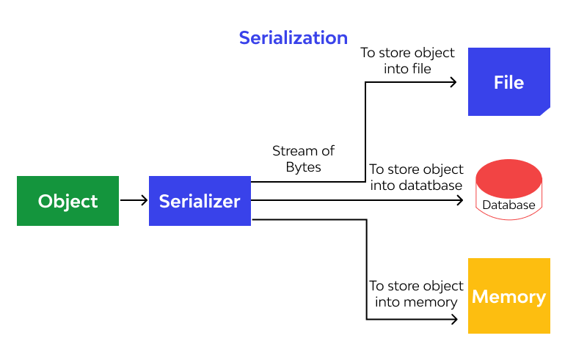
A8:2021- Software and Data Integrity Failures ← A8:2017-Insecure Deserialization
Software and data integrity failures :
Software and data integrity failures relate to code and infrastructure that does not protect against integrity violations. Integrity failures affect application software which relies upon plugins, libraries, or modules from untrusted sources, repositories, and content delivery networks (CDNs). New 2021 vulnerability category in OWASP.
This category stands by itself for 2 reasons:
The A06:2021 category “Vulnerable and Outdated Components” groups vulnerabilities derived from individual software components while A08 groups vulnerabilities injected into the payloads of otherwise benign artifacts before delivery.
It remains the best category for deserializing untrusted data.
Types of attack
Update without signing. For example, home routers, set-top boxes and device firmware
do not verify updates via signed firmware.
SolarWinds malicious update.
Insecure Deserialization.
Prevention
Ensure libraries and dependencies consume trusted repositories.
Ensure CI/CD pipeline has adequate security configuration.
Ensure unsigned or unencrypted serialized data is not sent to untrusted clients
without integrity check or digital signature.

Slide 17
A8:2021- Software and Data Integrity Failures ← A8:2017-Insecure Deserialization
Insecure Deserialization:
Insecure Deserialization is a vulnerability where deserialization flaws allow an attacker to remotely execute code in the system.
Types of attack:
Object and data structure related attacks. The attacker modifies application logic or achieves arbitrary remote code execution.
Access-control-related attacks where existing data structures are used but the content is changed.
Detection depends on the programming language.
Java Deserialization Scanner
Serial Analyzer
Jinfinity
Prevention
Reject deserialized objects from untrusted sources.
Restrict network connectivity from servers sending deserialized objects.
Isolate running code which deserializes in low privilege environments.
Attack Example Scenario
A PHP forum uses PHP object serialization to save a “super” cookie, containing the user’s user ID, role, password hash, and other state: a:4:{i:0;i:132;i:1;s:7:"Mallory";i:2;s:4:"user";
i:3;s:32:"b6a8b3bea87fe0e05022f8f3c88bc960";}
An attacker changes the serialized object to give themselves admin privileges: a:4:{i:0;i:1;i:1;s:5:"Alice";i:2;s:5:"admin"; i:3;s:32:"b6a8b3bea87fe0e05022f8f3c88bc960";}

Slide 18
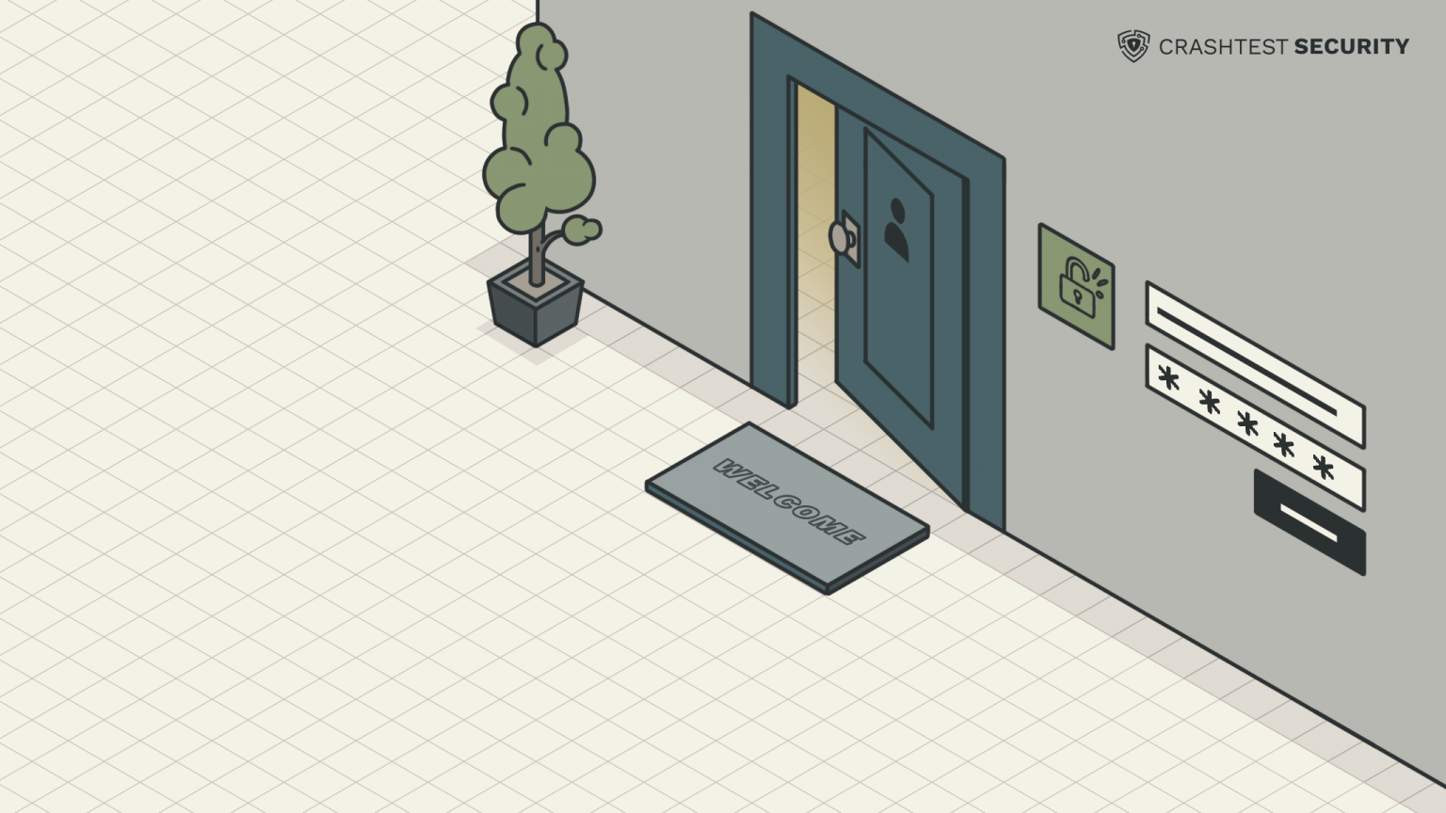
A09:2021 – Security Logging and Monitoring Failures ← A10:2017 - Insufficient Logging & Monitoring
Insufficient logging and monitoring is, missing security critical information logs or lack of proper log format, context, storage, security and timely response to detect an incident or breach.
Types of attack: Botnet Attacks, DNS Attacks, Insider Threats.
Fundamental reasons causing insufficient logging & monitoring systems:
Unlogged events and transactions.
Missing log backups & breach escalation plans.
Poor authentication management.
Ineffective training on logging and monitoring
Prevention
Ensure login, access control failures, and server-side input validation failures are logged with sufficient user context for suspicious accounts identification.
Ensure high-value transactions have an audit trail with integrity controls to prevent tampering or deletion, such as append-only database tables.
Establish effective monitoring and alerting to detect and respond to suspicious activities in a timely fashion.
Use application protection framework such as AppSensor.

Slide 19

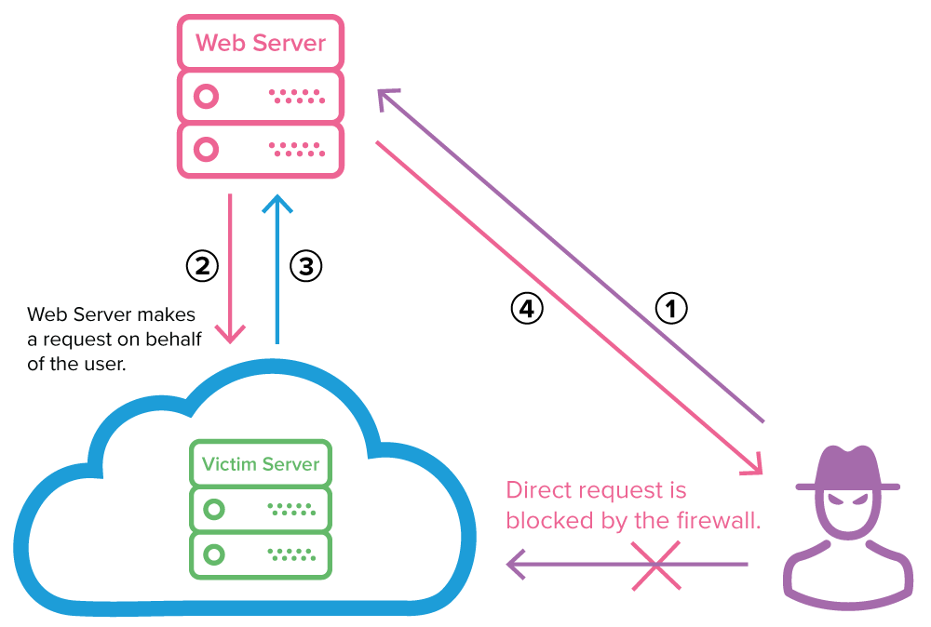
A10:2021 – Server-Side Request Forgery (SSRF) NEW
In a Server-Side Request Forgery (SSRF) attack, the attacker can abuse functionality on the server to read or update internal resources. This kind of attacks allow an attacker to make requests to any domains through a vulnerable server by making the server connect back to itself, to an internal service or resource, or to its own cloud provider.
Types of attack
Attack Against the Server—Injecting SSRF Payloads.
XSPA—Port Scanning on the Server.
Obtaining Access to Cloud Provider Metadata.
Detection
Dynamic application security testing (DAST) for vulnerability scanning such as Netsparker.
Prevention
implement firewall policies.
Implement HTTP CONNECT proxy (Smokescreen).

Slide 20
Bibliography:
‌OWASP (2021). OWASP Top Ten. [online] Owasp.org. Available at: https://www.google.com/url?sa=t&rct=j&q=&esrc=s&source=web&cd=&cad=rja&uact=8&ved=2ahUKEwiOtrSZ1Z_0AhV4gP0HHbgcDooQFnoECAkQAQ&url=https%3A%2F%2Fowasp.org%2Fwww-project-top-ten%2F&usg=AOvVaw3q5_mdZZBOIUp7TKNCuUgl [Accessed 17 Nov. 2021].
www.synopsys.com. (n.d.). What Is the OWASP Top 10 and How Does It Work? | Synopsys. [online] Available at: https://www.google.com/url?sa=t&rct=j&q=&esrc=s&source=web&cd=&cad=rja&uact=8&ved=2ahUKEwin1bXm1Z_0AhU7hP0HHaRpAeoQFnoECAYQAw&url=https%3A%2F%2Fwww.synopsys.com%2Fglossary%2Fwhat-is-owasp-top-10.html&usg=AOvVaw2Hp-GFRbz56F5eMuksYHk_ [Accessed 17 Nov. 2021].
‌owasp.org. (n.d.). Table of Contents | OWASP. [online] Available at: https://owasp.org/www-project-top-ten/2017/ . [Accessed 10 Nov. 2021].
Google.com. (2017). [online] Available at: https://www.google.com/url?sa=t&rct=j&q=&esrc=s&source=web&cd=&cad=rja&uact=8&ved=2ahUKEwjV4vmf15_0AhXAiv0HHfeTCuoQFnoECAUQAQ&url=https%3A%2F%2Fowasp.org%2Fwww-project-top-ten%2F2017%2F&usg=AOvVaw1J-pla3xU8D4H9zN6Mt_qx [Accessed 17 Nov. 2021].
Sucuri. (n.d.). OWASP Top 10 Security Vulnerabilities 2021. [online] Available at: https://sucuri.net/guides/owasp-top-10-security-vulnerabilities-2021/ [Accessed 10 Oct. 2021].
‌Google.com. (2021). [online] Available at: https://www.google.com/url?sa=t&rct=j&q=&esrc=s&source=web&cd=&cad=rja&uact=8&ved=2ahUKEwjPh4mH2J_0AhW4_rsIHbtzBUoQFnoECAQQAQ&url=https%3A%2F%2Fowasp.org%2FTop10%2FA01_2021-Broken_Access_Control%2F&usg=AOvVaw30ih7WgWsjvkKuzhEFQKhn [Accessed 12 Oct. 2021].
Google.com. (2021). [online] Available at: https://www.google.com/url?sa=t&rct=j&q=&esrc=s&source=web&cd=&cad=rja&uact=8&ved=2ahUKEwjroqO12J_0AhVi8LsIHec7B8wQFnoECAQQAQ&url=https%3A%2F%2Fowasp.org%2FTop10%2FA02_2021-Cryptographic_Failures%2F&usg=AOvVaw0yfmj22h8FGd52MZksBIsV [Accessed 27 Oct. 2021].
Mateo Tudela, F., Bermejo Higuera, J.-R., Bermejo Higuera, J., Sicilia Montalvo, J.-A. and Argyros, M.I. (2020). On Combining Static, Dynamic and Interactive Analysis Security Testing Tools to Improve OWASP Top Ten Security Vulnerability Detection in Web Applications. Applied Sciences, 10(24), p.9119.

Slide 21

Σας ευχαριστούμε πολύ για την προσοχή σας!

